Slide 1
Ground rules
Sustainable
Our PPTs default mode is dark. Energy saved in every slide. Navigate through the bright cover slides and use the Knowit-black-background for everything else.
Accessible
Our columns are narrow and line lengths short for an easy, and accessible read
Keep it simple
Highlight only what strengthens your story. Leave everything else behind. And make every illustration count ☺

Slide 2
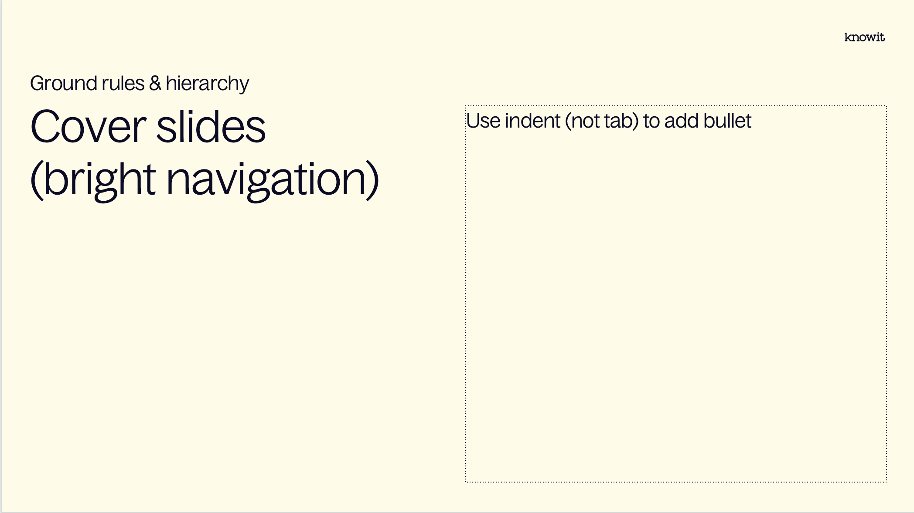
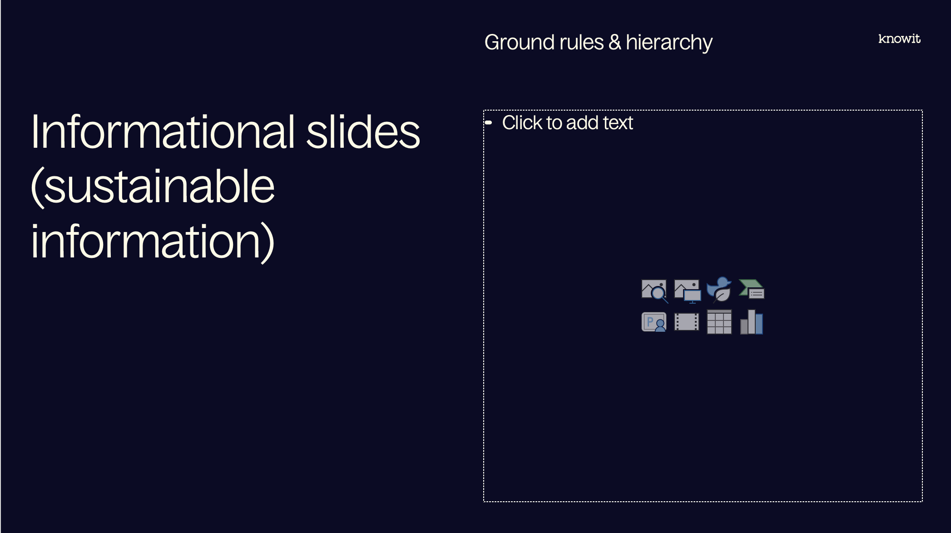
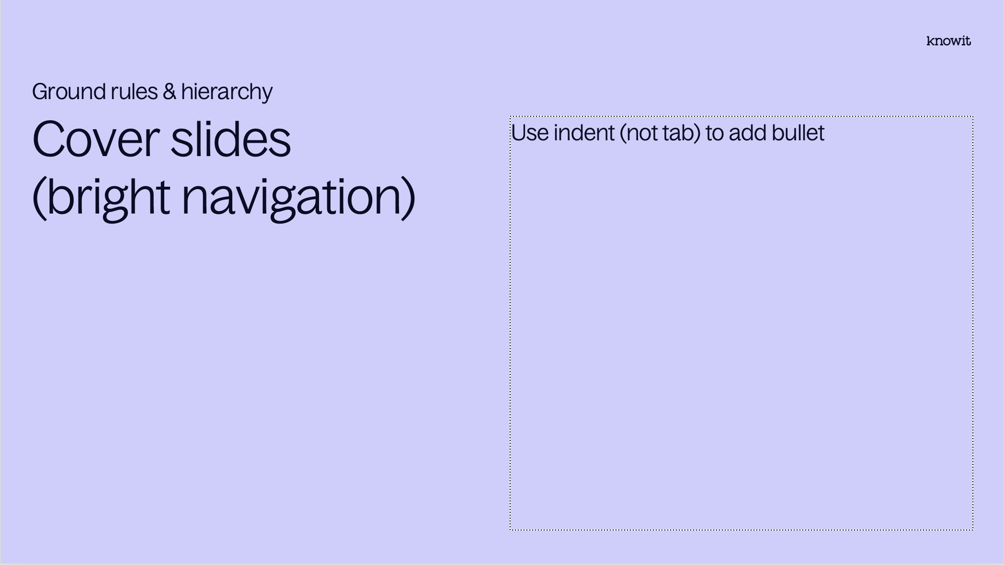
Visual prioritization

Slide 3
PowerPoint skills
Tips
Our template contains 38 different layouts, choose with care (and ask a colleague if you can’t find them)
The layout names might be helpful
Confused about colors or typographic rules? Check out the margins for some guidance
Have fun! (Break some rules if it helps you elevate your kick-ass-content☺)

Slide 5
Embedded academy Assembler and compilers

Slide 6
Content
Introduction
ARM assembler
Map and list files
Debugging
Testing assembler code
Compiler flags

Slide 7
Lab
Introduction
In this week’s lab we are going to convert the blink-function from last week to do parts of the implementation straight in assembler.

Slide 8
Notes from previous session

Slide 9
Reminder for today
Notes from last session
Stack
Flash
RAM

Slide 10
ARM assembler

Slide 11
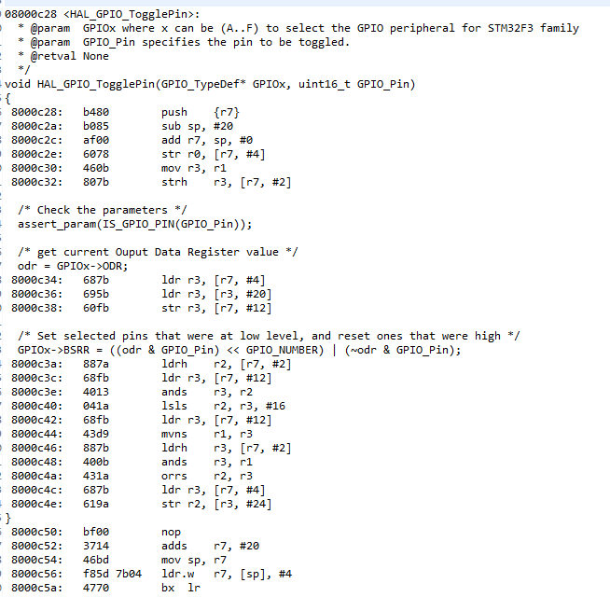
What is assembler?
ARM assembler
Low level code, close to machine code
Different kinds of assembler depending on processor architecture
ARM, x86 and x86-64 most common architectures
ARM mainly used in embedded systems
Different kinds of ARM instruction sets

Slide 12
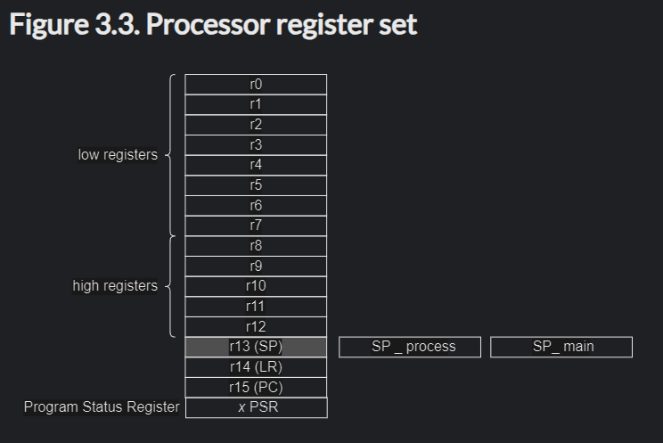
Processor registers
ARM Assembler
Rm, general registers
SP, stack pointer
LR, link register
PC, program counter

Slide 13
Assembly instructions
ARM Assembler
ADD adds registers or values
ADD r1, r2, r3 means r1 := r2 + r3
SUB subtracts registers
SUB r1, r2, r3 means r1 := r2 – r3
MOV copies a value to a register
MOV r1, r2 means r1 := r2
MUL, DIV multiplies and divides respectively
AND performs bitwise and
OR performs bitwise or
ASR performs an arithmetic shift right
LSR performs a logical shift right

Slide 14
Assembly instructions
ARM Assembler
STR stores a register at a memory address
STR r1, [r7, #8] stores the value of r1 at the memory location of r7+8, RAM[r7+8] := r1
LDR load value from a memory address
LDR r1, [r7, #8] loads the value from memory of r7+8 into r1 r1 := RAM[r7+8]
CMP compares two values, subtracts two values and discards the result but update NZCV-flags
CMP r1, r2 performs r2-r1 and sets flags accordingly. If they are equal Z is set to one, if r1 is larger than r2 N is set to 1
B branches, or jumps, to labled PC-relative address
B .function will jump the program counter to the where .function is stored in memory
BX lr will change the program counter to the address stored in lr, normally a return.
PUSH stores a register value to the stack and updates the stack pointer
POP loads a register value from the stack and updates the stack pointer

Slide 15
Condition code suffixes
ARM Assembler
Can be added as a suffix to most instructions
Will look at the NZCV registers from previous operation to evaluate condition
EQ equals
NE not equal
GE signed greater or equal
LS unsigned lower or same
CMP r1, r2 compares r1 and r2
BLE .jump branches to .jump if the value in r1 is signed less than or equal to the value in r2

Slide 16
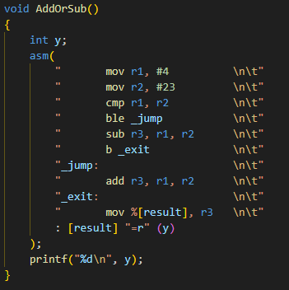
Examples
ARM Assembler
Assembler code can be written directly in C with the asm() function
The asm()-block can take inputs and outputs to interact with C code

Slide 17
Map and list files

Slide 18
Map files
Map and list files
Contains static symbols and their address
Produced by the linker
Contents can be controlled with a linker script
Useful for error originating from RAM

Slide 19
Map file sections
Map and list files
.text, contains instructions located in flash
.rodata, contains constants located in flash
.data, contains initialized variable, copied from flash to RAM during startup
.bss, contains uninitialized variables, stored in RAM, often (but not guaranteed) initialized to 0

Slide 20
List files
Map and list files
Contains assembly code and its address
Often C-code in between for clarity
Can also contain error and warning messages
Might also be used to determine memory and stack usage

Slide 21
Debugging

Slide 22
Debugging C
Debugging
Debugging C code is usually difficult
Hard crashes often only return an address where the crash occurs
Map and list files useful
Debugging tools available to step through the software

Slide 23
Debugging real-time systems
Debugging
Debugging real-time systems is usually difficult
Hard to use debugging tools to step through code
Work around by modifying code and using potential user interfaces for printouts

Slide 24
Testing assembler code

Slide 25
Testing on hardware
Testing assembler code
Instruction stepping mode lets you step through assembly code
Disassembly usually available
Possible to change register values to change behaviour of code

Slide 26
Testing on computer
Testing assembler code
Usually running on x86 architecture and code is compiled for ARM
QEMU lets us emulate ARM architecture
gdb-multiarch can be used to check registers and step through arm code without hardware
Lots of other tools available

Slide 27
Compiler flags

Slide 28
Compiler flags
Compiler flags
Lots of different flags, both for gcc and for ld
Optimization
Ranges from –O0 to –O3 and some other special versions such as –Os
Higher number increases compile time and performance of code
Higher number makes debugging harder
-O0 is default and useful when debugging
-Os is –O2 but optimized for size, common in production
Debug
-g sets debug level when using gdb
-g0 is nu debug information and –g3 is maximum.
–g will use level 2, default debug information
Generate map and list files
-Wl,-Map=output.map will generate a map file
objdump responsible for generating list file
objdump –h –S output.elf > “output.list”

Slide 29
Questions?

Slide 30
Lab part

Slide 31












































































Our icons

Slide 32

















UN SDG (PNG)

Slide 33

















UN SDG (SVG)

